Slide 1
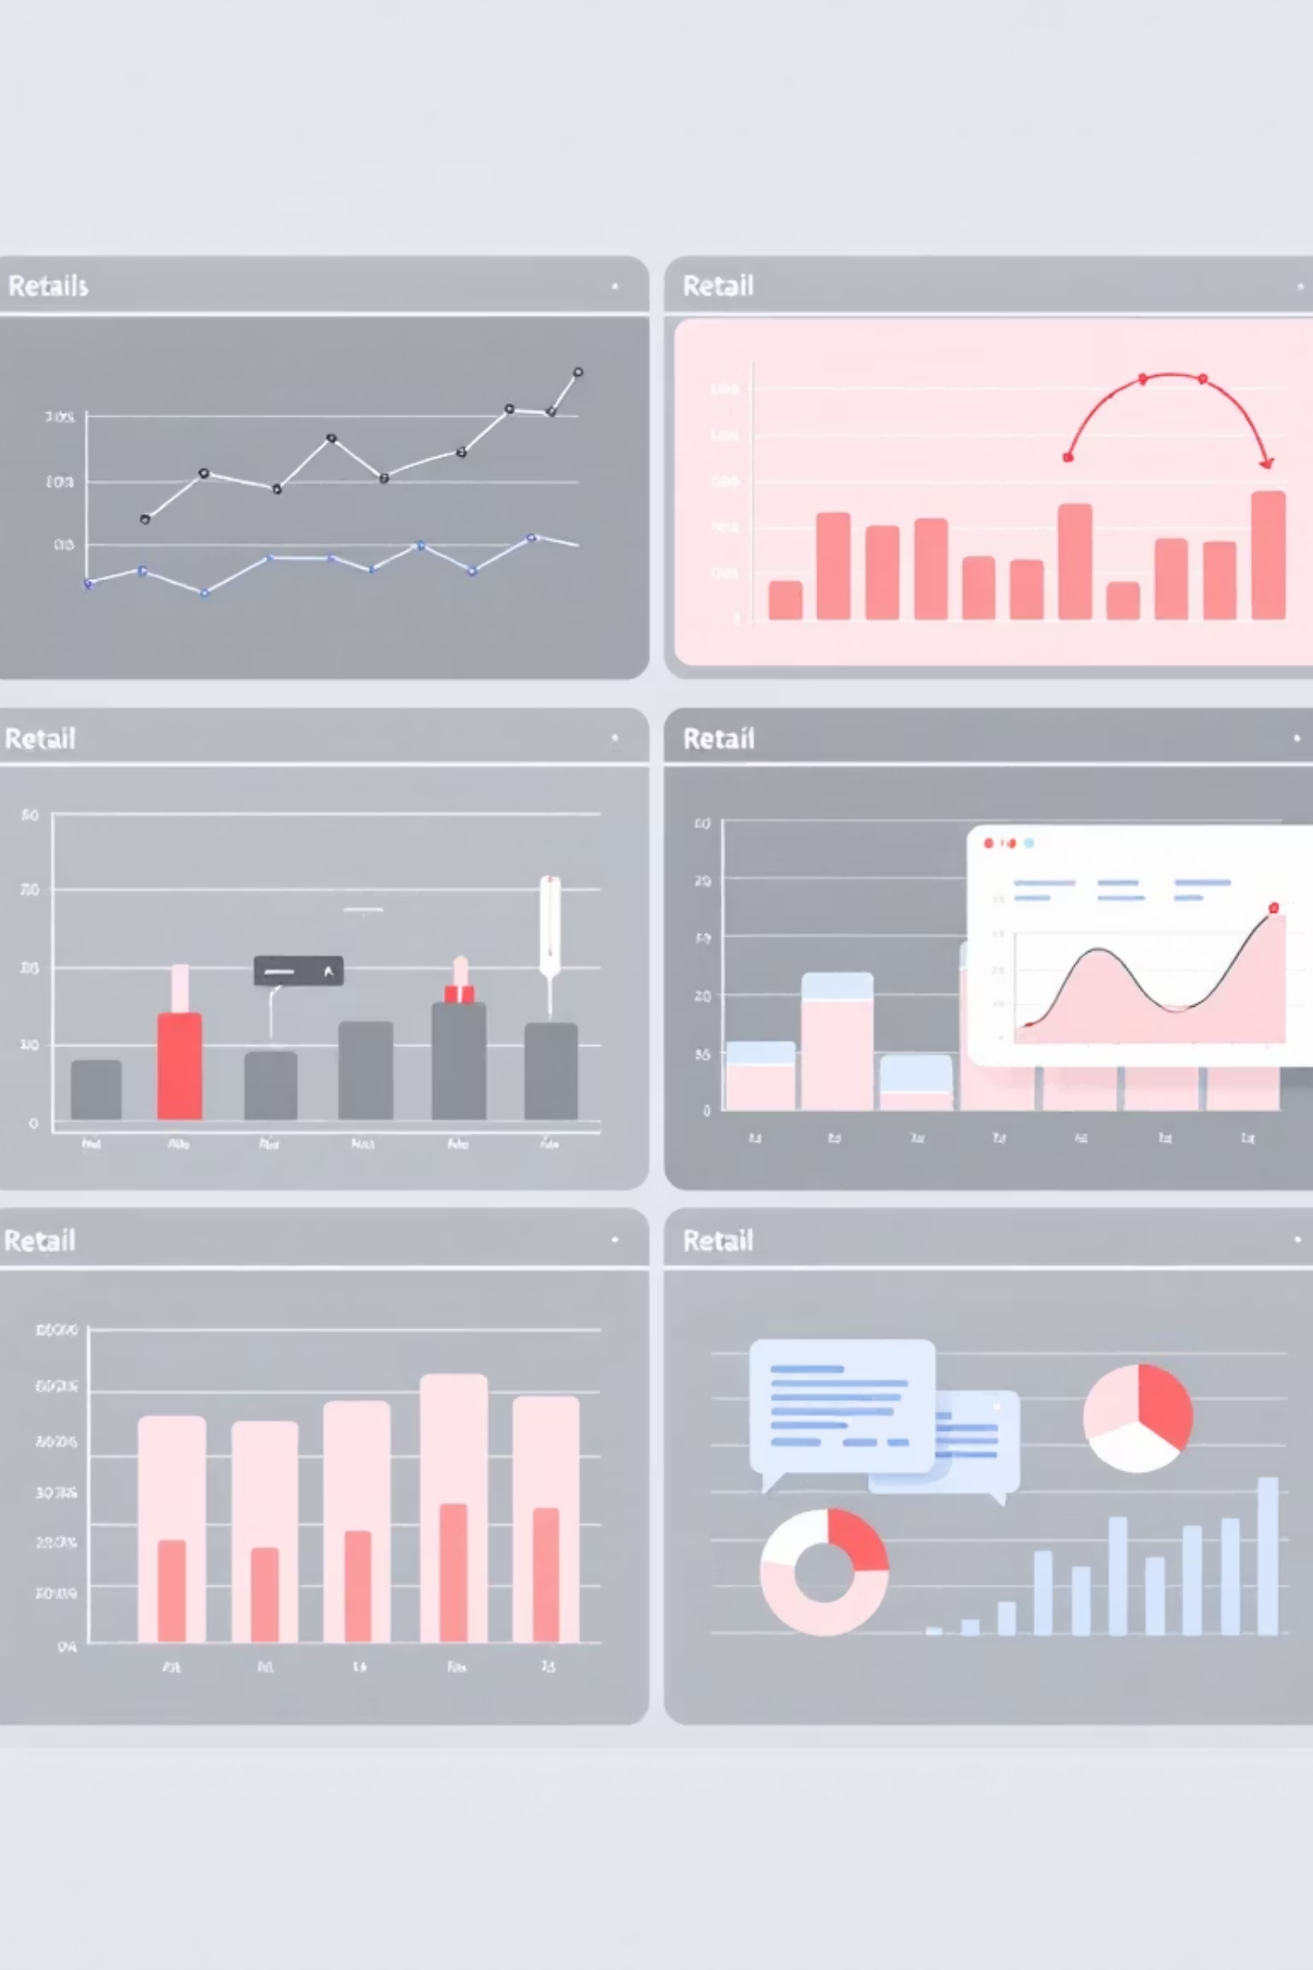
Integrated Retail Analytics for Store Optimization
Utilizing machine learning and advanced analytics to optimize store performance, forecast demand, and enhance customer experience through intelligent segmentation strategies.

Slide 2
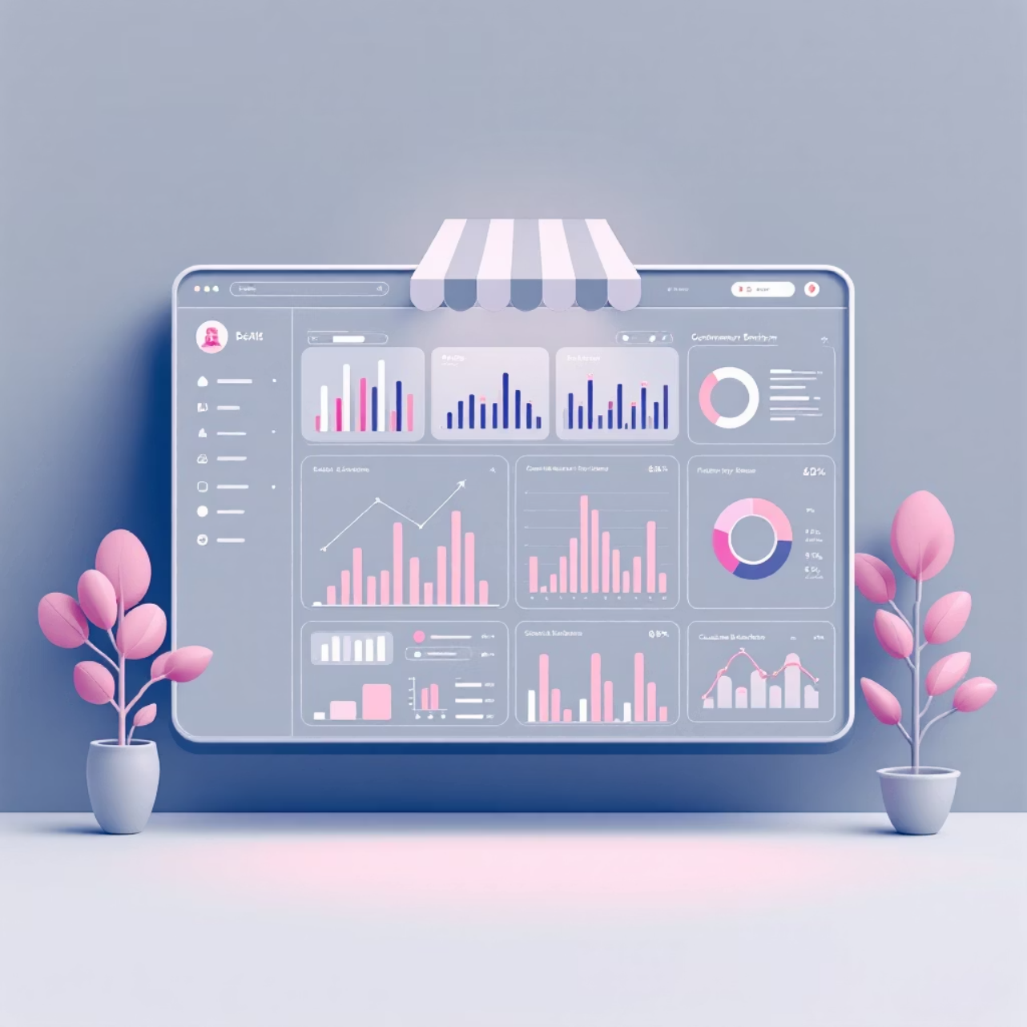
Project Overview & Strategic Goals
Core Objectives
Optimize store performance through data-driven insights
Forecast demand with machine learning precision
Enhance customer experience via targeted segmentation
Implement personalized marketing strategies at scale
This comprehensive analytics initiative leverages multiple data science techniques to transform retail operations and drive measurable business outcomes.

Slide 3

Anomaly Detection Framework
Sales Pattern Analysis
Root Cause Investigation
Identify unusual sales patterns across stores and departments using statistical thresholds and machine learning algorithms.
Investigate potential causes including holidays, markdowns, and economic indicators to understand anomaly sources.
Data Quality Enhancement
Implement anomaly handling strategies through data cleaning, normalization, and imputation techniques.

Slide 4
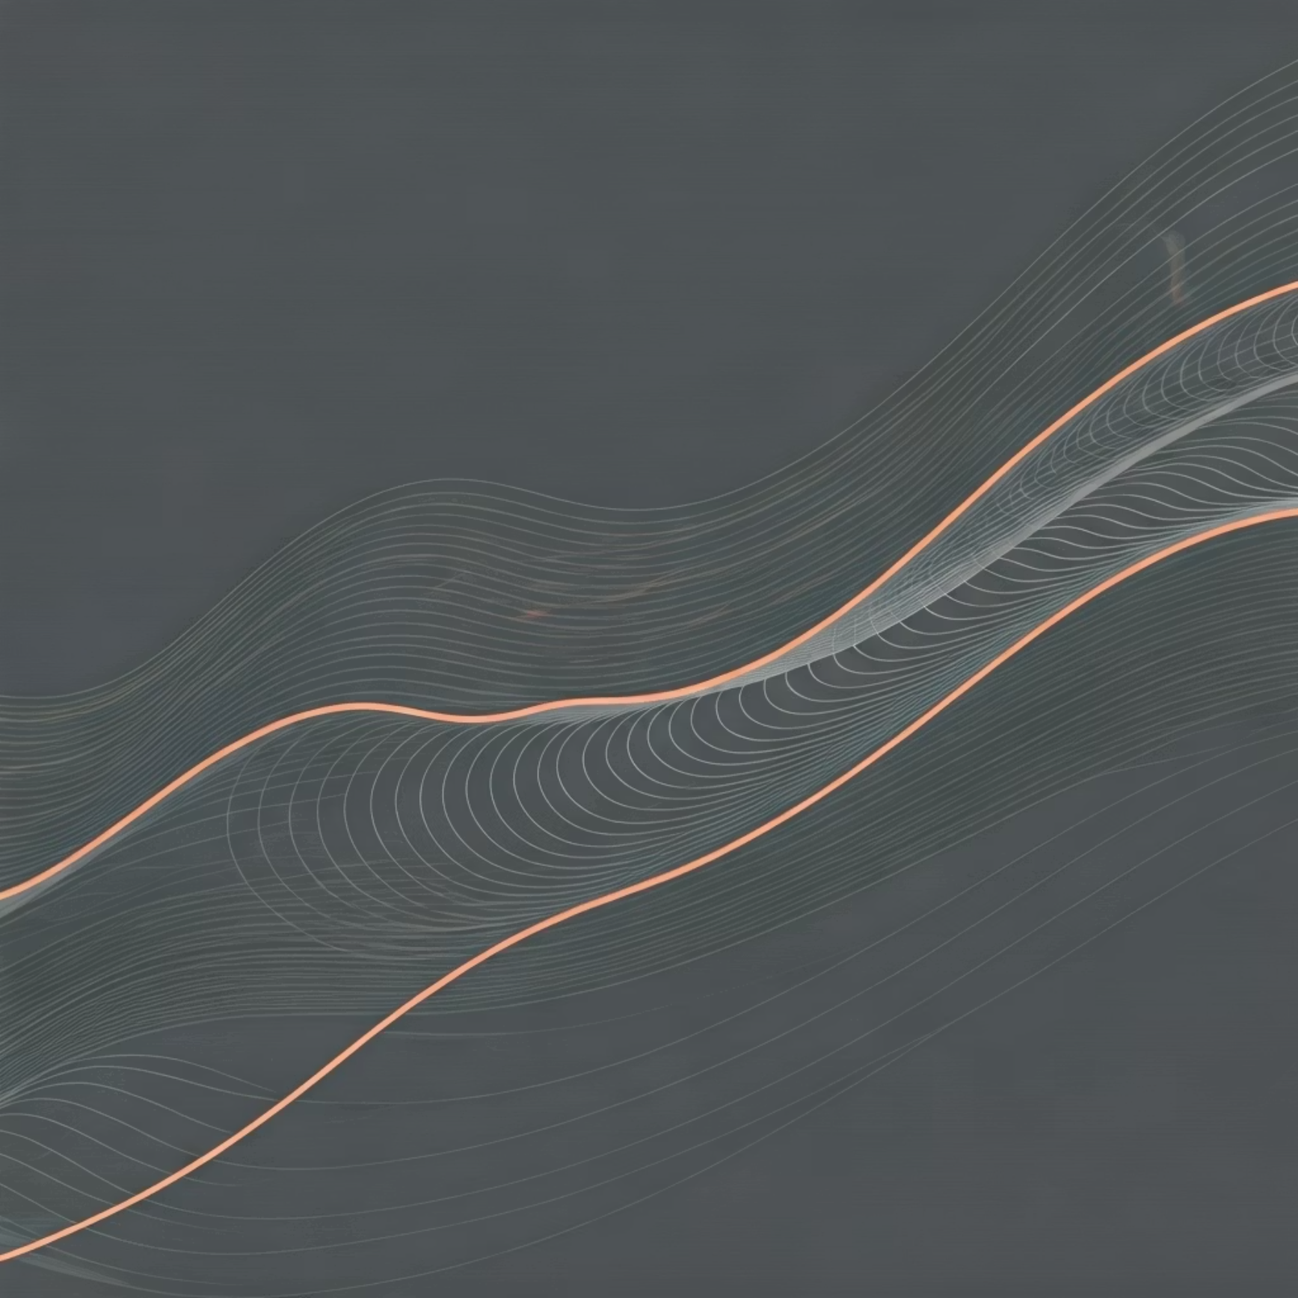
Time-Based Analytics & Seasonal Intelligence
Temporal Analysis Methods
Implementation Strategy
Rolling Statistics: Calculate moving averages and standard deviations to track variations
Set dynamic thresholds and visual cues to highlight significant deviations from smoothed baseline values, enabling proactive anomaly detection.
Exponential Smoothing: Apply EMA techniques for trend identification
Seasonal Detection: Identify holiday effects and cyclical patterns

Slide 5

Data Engineering & Feature Development
01
02
Missing Value Handling
Feature Engineering
Systematic approach to MarkDown data gaps using advanced imputation techniques and domain expertise.
Create predictive features incorporating store size, regional factors, and economic indicators.
03
EDA Implementation
Comprehensive analysis using barplots, line charts, violin plots, and correlation matrices for pattern discovery.

Slide 6



Customer Segmentation Excellence
K-Means Clustering Analysis
Applied unsupervised machine learning to segment stores and departments based on sales patterns and regional characteristics.
4
4
Quality Metric: Silhouette score evaluation determined optimal cluster count of 4 for both store and department segments.
Optimal Clusters
Department Groups
Store segments identified
Department clusters created
0.85
Silhouette Score
High-quality segmentation

Slide 7
Store Segment Personalization Strategy
1
2
Premium Space Retailers
Value-Oriented Stores
Sizeable luxury stores targeting high-value customers with premium product positioning and exclusive experiences.
Balanced approach combining quality products with competitive pricing to serve price-conscious shoppers.
3
4
Budget-Friendly Stores
Compact Elegance Stores
Cost-focused operations emphasizing volume sales and essential products for budget-conscious consumers.
Smaller footprint locations offering curated selections with emphasis on convenience and targeted demographics.

Slide 8

Market Basket Analysis & Cross-Selling
Apriori Algorithm Implementation
Leveraged association rule mining to identify product relationships and cross-selling opportunities within departments.
Analyze purchase patterns across product categories
Identify frequently bought together items
Develop strategic cross-selling recommendations
Generated actionable insights for product placement and promotional strategies despite limited individual transaction data.

Slide 9




Demand Forecasting Model Portfolio
SARIMA Model
Short-term forecasting for operational decisions within weeks to months timeframe.
Random Forest
Long-term strategic forecasting spanning months to years for planning initiatives.
Holt-Winters
Triple exponential smoothing capturing level, trend, and seasonality components.
Comprehensive forecasting approach incorporating CPI, unemployment rates, fuel prices, and store attributes for enhanced accuracy.

Slide 10
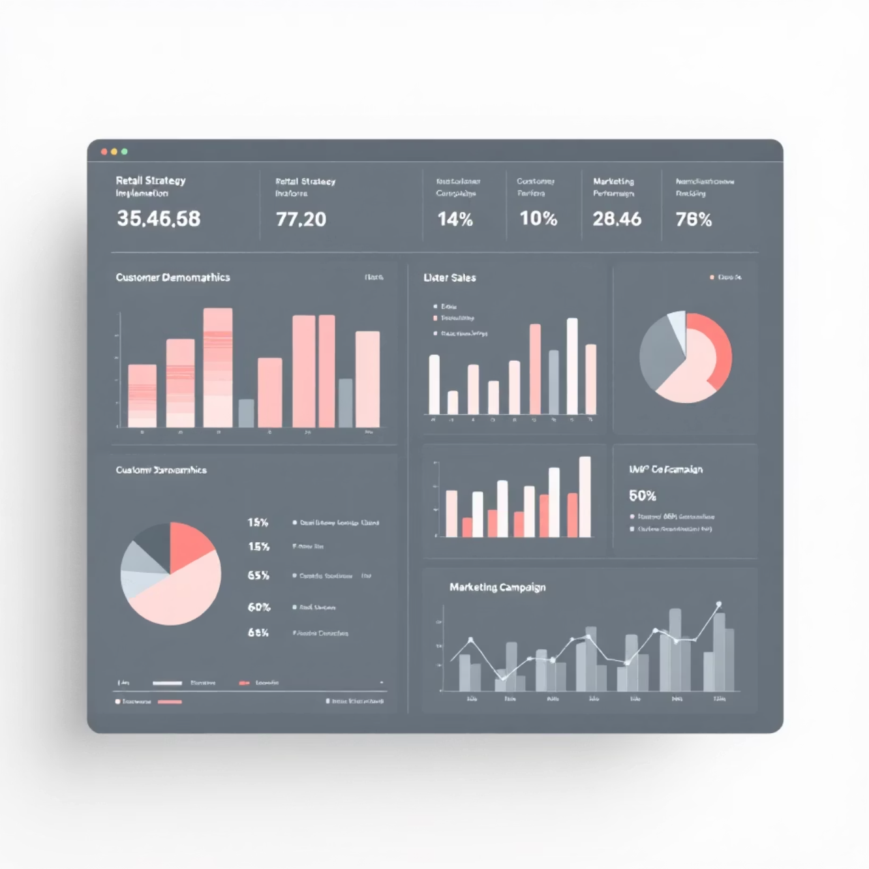

Strategic Implementation & Real-World Impact
Comprehensive Strategy Framework
Inventory Optimization: Tailored management strategies for each store segment
Marketing Personalization: Targeted campaigns based on customer segmentation
Economic Integration: External factor incorporation for robust forecasting
Performance Monitoring: Continuous evaluation of segmentation quality
This integrated approach transforms retail operations through data-driven decision making and measurable business outcomes.
Next Steps: Pilot implementation with A/B testing to validate model performance and business impact.

